Slide 1
DATABASE MANAGEMENT SYSTEM – MCA
I Semester
AUG 2024

Slide 2
Relational Model

Slide 3

Introduction To Relational Model
A data model is a collection of conceptual tools.
Relational Database Model is the most common model in industry today.
A relational database is based on the relational model developed by Edgar. F. Codd (12 rules).
The relational model- collection of tables and the relationships among those data.
A relational database consists of a collection of tables, each table is assigned with unique name.
Correspondence between the concept of table and the mathematical concept of relation
Notes:
Lesson 3- Discussing about Relational model structure, concepts of Keys.
E F Codd’s 12 Rules-
Codd’s Twelve Rules
Dr. Codd proposed the normalization rules we used to design databases, but did you know that he also came up with rules that vendors must meet to call their products relational database systems? In this article, Joe Celko explains the thirteen RDBMS rules.
Let me take you back to those thrilling days of yesteryear when the relational model and relational databases were the fads that all hip kids were getting into. Yes, we have fads in IT. Sometimes it’s a new programming language that will solve all of our problems. Think about PL/1, Ada, and dozens of others that have come and gone. Sometimes it’s a new technique that will solve our problems. Structured Programming, Software Engineering, Agile, and others I have forgotten. We used to joke that the current “fad du jour” was like teenage sex. Everyone claimed they knew what it was; they were already doing it and had always done it, but they were a little weak on some of the details.
Software vendors were particularly bad about this. Any database product they had was relational! Just ask the salesperson; you know salespeople never lie. Dr. Codd, the creator of relational databases, was bothered by this, so he set up a set of 13 rules that a product had to match to be considered relational. The paper is referred to as “Codd’s Twelve Rules” or sometimes as “Codd’s Twelve Commandments”, despite the fact there were actually 13 of them because the numbering started with zero. In particular, Rule 12 was created to prevent some of this marketing hype.
I’ll begin by going through the rules.
Rule 0: The Foundation Rule
For any system that is advertised as, or claimed to be, a relational database management system, that system must be able to manage databases entirely through its relational capabilities. This means you don’t get to use a host language to do anything inside the database. If you remember the original database systems, they had to be embedded in COBOL or some other host language. They were essentially collections of procedure calls for data access, rather than what we would think of is a database today.
Rule 1: The Information Rule
All information in a relational database is represented explicitly at the logical level and in exactly one way – by values in tables.
Notice the phrase “logical level” and that there’s nothing about how physical storage is done. There’s nothing about pointer chains. There’s nothing about the physical position of data in arrays, files, or anything else. Remember that Dr. Codd started as a mathematician, so he thought abstractly. Today, this rule is worded as “scalar values in the columns of rows in tables”, but various vendor implementations allow non-scalar data in the table.
There is also some confusion about “atomic” versus “scalar”; a value is atomic if it cannot be further decomposed without losing information. For example, an American shoe size of 8½ B is a complete measurement. Either the length (8½) or the width (B) by itself has lost information about the actual shoe size. The term scalar has to do with scales and measurements, and I have written separate articles on this topic.
Rule 2: The Guaranteed Access Rule
Each and every datum (atomic value) in a relational database is guaranteed to be logically accessible by resorting to a combination of table name, primary key value and column name.
Please note Dr. Codd was still talking about a “primary key” at this time. This particular term also is part of SQL. We still agree that to have a table, you must have a key because that’s how data is located in RDBMS.
But the concept of a primary key was a leftover from sequential files; it’s so ubiquitous that we didn’t even think about it. To use a sequential file, the data has to be sorted on a key. Obviously, you can have only one such sort key. A bit later, Dr. Codd realized that all keys are keys at the logical level. To paraphrase “Animal Farm”, we realized you couldn’t have some keys “more equal than others”, so there was no need to make one special.
Rule 3: Systematic Treatment of NULL Values
NULL values (distinct from the empty character string or a string of blank characters and distinct from zero or any other number) are supported in fully relational DBMS for representing missing information and inapplicable information in a systematic way, independent of data type.
This is another concept that’s grown since Codd’s original paper. In the second version of the relational model, Dr. Codd defined “applicable” and “inapplicable” forms of NULL. An applicable NULL, a type A NULL, is used when the entity has the attribute, but we don’t know what its value is right now. An inapplicable NULL, a type I NULL, is used when the entity simply doesn’t have the attribute, so its value cannot ever be resolved.
Because these two NULLs did not come along until after we had gotten pretty far into SQL, the language only has one NULL which serves both purposes. Unfortunately, it gets more complicated after that.
The first complication is that Dr. Codd defined the NULL as having no data type. When you’re implementing a compiler in a strongly typed language like SQL, you really need a data type for all of the data elements. This is why we have to write CAST (NULL AS < data type>) to play safe, and why being NULL-able is a part of the declaration of a column in the DDL.
The second complication is how a NULL sorts. Is it always higher than any value in the datatype of the column? Always lower? Originally, each vendor could have his own rules. Currently, the ANSI/ISO standards let the programmer explicitly determine how NULLs are sorted.
The third complication is that even if you have declared everything in your schema to be NOT NULL, SQL will generate NULLs. There is no escape! The OUTER JOINs create NULLs in the unpreserved table, to pad out the rows in the result. In some cases, returning an empty set will be shown as a NULL. We also have NULLs created by an OLAP operation. OLAP is worth an article in its own right, but for now, consider the basic operations that are options in the GROUP BY clause; CUBE, ROLLUP, and GROUPING SET operations.
Looking at just the ROLLUP as a representative example, this lets us write what we would have called a “control break” report in the old days. These are the basic reports that would list the details, and then at each level of the hierarchy, print out aggregate functions (usually summations) between the groups. For decades, this was the major use of computers and green bar continuous printer paper and data processing.
But unlike a report, the result of a query has to return a table. And by definition, the rows in the table all have the same structure. This is one that’s easier to see an example. Assume I have a simple table of sales data:
CREATE TABLE Sales
(state_code CHAR(2) NOT NULL,
city_name VARCHAR(20) NOT NULL,
sales_amt DECIMAL(12, 2) NOT NULL,
PRIMARY KEY (state_code, city_name));
My OLAP query gives me the totals at the state level and the city level:
SELECT state_code, city_name, SUM(sales_amt) AS sales_total
FROM Sales
GROUP BY ROLLUP(state_code, city_name);
The resulting output from this query looks like this:
AL Birmingham 200.00 ← detail rows
…
AL NULL 4500.00 ← state-level total rows
….
NULL NULL 115000.0 ← grand total row
Much like the OUTER JOINs, the OLAP operations create NULLs which were not in the original data. As is usual with grouping in SQL, the NULLs are treated as a group in their own right. But there’s a serious problem here. What does the NULL at these various levels mean? It’s not quite the same as an A-type or I-type missing value. For example, we were looking at a row that gives the city level totals. There are no NULLs at this level, but when I go to the state level, my NULL represents shorthand for a subset of the names of cities. This is a very different meaning than the NULLs which were used as a scalar value.
As expected, the NULLs form their own group. However, I would tell the difference between a created NULL and one that was in the original data? The solution which we got in the SQL: 2003 standard, is a function:
GROUPING (< column reference 1>, .., < column reference n>)
This function returns a vector where a one means the NULL was created by the query, and otherwise a zero.
SELECT CASE GROUPING (state_code) WHEN 1
THEN 'State Totals' ELSE state_code END state_level,
CASE GROUPING (city_name) WHEN 1
THEN 'City Totals' ELSE city_name END city_level,
SUM(sales_amt) AS sales_total
FROM Sales
GROUP BY ROLLUP(state_code, city_name);
Another consideration with NULLs is when we use them with temporal data. The ISO-8601 standards are based on a half-open interval model of time. That means we always know the starting point in time of an interval, but there may or may not be an ending point yet. If the event is still ongoing, we can’t terminate it. This is why there is no such thing as 24:00:00 Hrs today because it is actually 00:00:00 Hrs of the next day.
The classical way of modeling ongoing events is to use NULL for the ending timestamp. This lets us write things like COALESCE(event_ending_timestamp, CURRENT_TIMESTAMP) in our queries. But it also means that a NULL can be interpreted as a symbol for “eternity”, which we don’t have in SQL.
Rule 4: Dynamic Online Catalog Based on the Relational Model:
The database description is represented at the logical level in the same way as ordinary data, so that authorized users can apply the same relational language to its interrogation as they apply to the regular data.
SQL products are generally pretty good about this, but you have to be careful that you don’t mix data and metadata. There are schema information tables defined in the standards. In the real world, each vendor has its own schema information tables, which also include things that are particular to its implementation.
Rule 5: The Comprehensive Data Sublanguage Rule
A relational system may support several languages and various modes of terminal use (for example, the fill-in-the-blanks mode). However, there must be at least one language whose statements are expressible, per some well-defined syntax, as character strings and that is comprehensive in supporting all of the following items:
1. Data definition.
2. View definition.
3. Data manipulation (interactive and by program).
4. Integrity constraints.
5. Authorization.
6. Transaction boundaries (begin, commit and rollback).
Again, SQL products are pretty good about this. Unless you’re a bit older, you might not have ever seen QBE (query by example) or other tools. SQL is divided into three sublanguages; DDL (data definition language), DCL (data control language) and DML (data manipulation language). When we were designing the sublanguages in the SQL standards, we very deliberately decided that the languages would be LALR(1). This it has to do with the type of grammar used by the parsers in a computer language. If you like having flashbacks to your compiler writing classes as a freshman, you could look up one of these two articles:
https://en.wikipedia.org/wiki/LALR_parser
https://web.cs.dal.ca/~sjackson/lalr1.html
Rule 6: The View Updating Rule
All views that are theoretically updatable are also updatable by the system.
This requirement simply does not work. Updatable views are incredibly complicated, and it’s not practical to try to implement it. In particular, you might want to read a book by Chris Date, “View Updating & Relational Theory: Solving The View Update Problem” (ISBN 9781449357849).
Vendors have pretty much settled for an updatable VIEW having to map to distinct rows in a single base table. Trying to do an “un-JOIN” on a VIEW built on more than one table is problematic. If the VIEW has computations, trying to come up with the inverse functions is not always possible. Throw in some CASE expressions, and it’s an incredible mess.
The WITH CHECK OPTION has been in the language almost since the beginning, but it’s not well understood. Again, it’s one of those things which is easier to explain with an example. Let’s assume we have a skeleton table of our salespersons:
CREATE TABLE Salespersons
(emp_id CHAR(10) NOT NULL PRIMARY KEY,
emp_name VARCAR(25) NOT NULL,
emp_city_name VARCAR(25) NOT NULL,
..);
Now create a VIEW from the salesman in Austin, Texas:
CREATE VIEW Austin_Salespersons
AS
SELECT emp_id, emp_name, emp_city_name
FROM Salespersons
WHERE emp_city_name = 'Austin, TX';
This is a perfectly good VIEW of all the guys working in Austin, Texas. Since it obviously has one row in the VIEW mapping to one row in the base table, we can write:
UPDATE Austin_Salespersons
SET emp_city_name = 'Boston, MA';
Oops! We just moved everybody out of Texas to Massachusetts. However, if we had put a WITH CHECK OPTION on the end of the CREATE VIEW statement, then the WHERE clause is reevaluated in such an update is disallowed because it moves rows out of the VIEW.
Rule 7: Possible for High-Level Insert, Update, and Delete
The capability of handling a base relation or a derived relation as a single operand applies not only to the retrieval of data but also to the insertion, update and deletion of data.
Obviously, insertion update and deletion can be done on base tables in every SQL product. However, the most complicated options are in the MERGE statement.
Rule 8: Physical Data Independence
Application programs and terminal activities remain logically unimpaired whenever any changes are made in either storage representations or access methods.
Again, SQL is pretty good about this feature. The older network and hierarchical databases required rewriting the code when a new index, hash table or whatever was added. You had to open a given index and explicitly use it specifically.
Rule 9: Logical Data Independence
Application programs and terminal activities remain logically unimpaired when information-preserving changes of any kind that theoretically permit unimpairment are made to the base tables.
Notice the idea is that the information is preserved, even when its representation is altered. For example, if you change a value from INTEGER to a DECIMAL(n, 0) data types, and don’t permit fractional data values, then you should expect either representation to behave the same way.
Again SQL is pretty good about this feature. A select statement runs as written, even after I’ve altered the tables. This concept was very hard for traditional programmers who grew up with traditionally compiled languages. If I compiled a Fortran program with a particular Fortran compiler, the executable code would always be the same. The same query run on the same version of SQL can produce different execution plans, depending on the other users (can we share data among them?), the current data types (I can alter a column within its data type family?), changed access methods and data statistics.
Rule 10: Integrity Independence
Integrity constraints specific to a particular relational database must be definable in the relational data sublanguage and storable in the catalog, not in the application programs.
Data integrity is part of the DDL in SQL. SQL engines allow column level constraints (CHECK(), DEFAULT, NOT NULL) and simple DRI table constraints (REFERENCES). In the ANSI/ISO standards, we also have a CREATE ASSERTION statement that is like a schema level CHECK() constraint. All constraints are true for an empty table, but an assertion can handle empty tables and multiple tables.
Rule 11: Distribution Independence
The end-user must not be able to see that the data is distributed over various locations. Users should always get the impression that the data is located at one site only.
This is a little more vendor dependent, but SQL has no syntax to locate the physical storage of the data. When we look at RAID storage, we have no idea where is the physical data is kept or even which copy of the data we are currently using. But if we mean a truly distributed database, in the sense of the Cloud or other network configurations, they didn’t exist when Dr. Codd set up these rules. In the years since then, managing a distributed database has become a separate topic in itself.
Rule 12: The Non-subversion Rule
If a relational system has a low-level (single-record-at-a-time) language, that low level cannot be used to subvert or bypass the integrity rules and constraints expressed in the higher-level relational language (multiple-records-at-a-time).
We have cursors for this! In fact, the SQL model is based on the IBM magnetic tape drive functions. We didn’t have much choice when we were setting up the first RDBMS products since the first products were built on top of existing file systems and hardware. There was not much parallelism, column-oriented data storage, advanced hashing, or any of the other advances in computer science and hardware. Later we added the SQL/PSM, PL/SQL, Informix 4GL, T-SQL in other procedural languages that would work on a particular vendor’s product.
While it is possible in SQL products to turn off constraints, the rule has always been that at the end of the session, the database must return to a consistent state with all of the constraints turned back on. The ANSI/ISO SQL Standard allows you to declare constraints as either being deferred initially, deferred later or not deferrable at all. SQL Server has commands to turn the constraints on and off explicitly.
Deferring constraints is usually done when you need to get an initial state in the database that has to do with self-referencing constraints. Such things are referred to as “the Garden of Eden constraints”, and they can be a bit tricky. For example, if a constraint on a new row to a table has to refer back to rows that already exist in the table. But if you’ve just created the table, there are no rows to reference! So we need to turn off this constraint, insert an initial row, and then turn it back on.

Slide 4
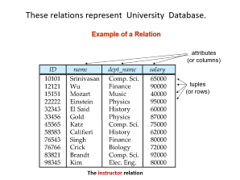
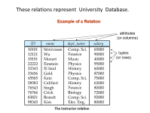
Properties of a relation
Each relation contains only one record type.
Each relation has a fixed number of columns that are explicitly named.
Each attribute name within a relation is unique.
No two rows(tuples) in a relation are the same.
Each item or element in the relation is atomic.
Rows have no ordering associated with them.
Columns have no ordering associated with them.

Slide 5
Relational Terminology
Terms | Definition
Relation instance | Set of rows(tuples), each row therefore has the same columns(attributes).
Tuple | It is a row in the relation.
Attribute | It is a column in the relation.
Degree of a relation | Number of columns in the relation
Cardinality of a relation | Number of rows in the relation
N-ary relation | Relation with degree N.
Domain | Set of allowed values for each attribute.

Slide 6
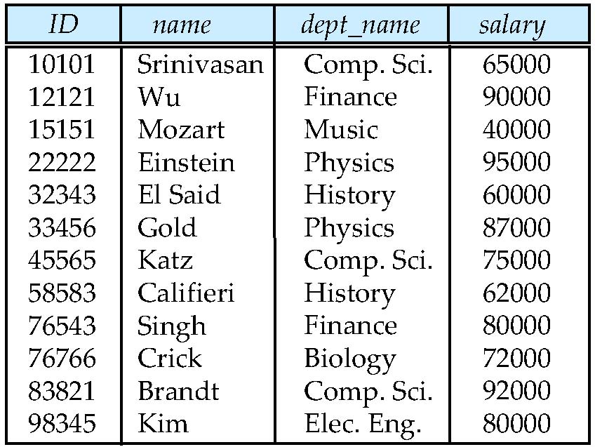
Example of a Relation
These relations represent University Database.
attributes
(or columns)
tuples
(or rows)
The instructor relation
Notes:
Example for relations in University database

Slide 7
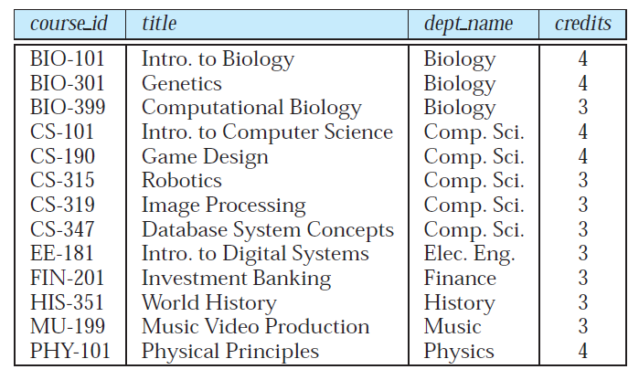
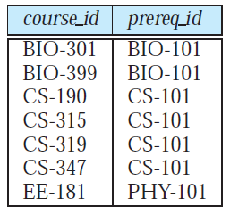
Example of a Relation
The prereq relation
The course relation.

Slide 8
Some Terms
Relation Instance: A specific instance of a relation, i.e.
set of rows in a relation at an instance.
In general, a relation schema consists of a list of Attributes and their corresponding domains.
Database schema, which is the logical design of the database.
Database Instance, which is a snapshot of the data in the Database at a given instant in time.

Slide 9
Attribute Types
The set of allowed values for each attribute is called the domain of the attribute.
  A valid range value for a Marks attribute may be 0-100
  Marks Domain is {0,1,2,..50,51,..100}
Attribute values are (normally) required to be atomic; that is, indivisible
The special value null is a member of every domain.
The null value causes complications in the definition of many operations.
Notes:
Null is not equivalent to empty space

Slide 10
Relation Schema and Instance
If A₁, A₂, …, A_{n} are attributes, then
R = (A₁, A₂, …, A_{n} ) is a relation schema
Example: instructor = (ID, name, dept_name, salary)
Let D₁, D₂, …. D_{n} be the Domains of A₁, A₂, …, A_{n} respectively.
Formally, given sets D₁, D₂, …. D_{n} a relation r is a subset of D₁ x D₂ x … x D_{n} (cartesian product)
Thus, a relation is a set of n-tuples (a₁, a₂, …, a_{n}) where each a_{i} ∈ D_{i}

Slide 11
Relation :
  A row in a table represents a relationship among a set of values.
  A table is a collection of such relationships, there is a close correspondence between the concept of table and the mathematical concept of relation.
Ex:
Cours_IDs set A={ BIO_301,BIO_399,CS_190,…} ( set of all valid Course_ID)
Prereq_IDs set B={ BIO_101,CS_101,..} ( set of all valid Prrereq_ID)
A x B ={ (BIO_301, BIO_101),(BIO_301,CS_101),.. (BIO_399,BIO_101), (BIO_399,CS_101),..
(CS_190, BIO_101),(CS_190,CS_101),..
}
  A set (table in previous slide) Prereq is a subset of A x B
  Prereq ={(BIO_301, BIO_101), (BIO_399,BIO_101), (CS_190, CS_101),…} is a Relation.
  Compare it with Prereq relation

Slide 12
A x B ={ (BIO_301, BIO_101),(BIO_301,CS_101),.. …,(BIO_399,BIO_101), (BIO_399,CS_101),..
….,(CS_190, BIO_101),(CS_190,CS_101),..
}
A x B gives all possible combinations of domain values, which involve real world facts-
such as (BIO_301, BIO_101) i.e. for Course BIO-301, BIO-101 is Prerequisite course.
Also A x B is having information such as (BIO_301,CS_101) which is not a real world fact.
A relation such as Prereq is the subset of A x B
which represents real world fact.
  Prereq ={(BIO_301, BIO_101), (BIO_399,BIO_101), (CS_190, CS_101),…}
Notes:
A relation such as Prereq

Slide 13
Keys
A superkey is a set of one or more attributes that, taken collectively, allow us to identify uniquely every tuple in the relation.
Let K ⊆ R, K is a superkey of R if values for K are sufficient to identify a unique tuple of each possible relation r(R)
  Example: {ID} and {ID , name} are both super keys of instructor.
  Instructor(ID, Name, Dept_Name, Salary)
  i.e R={ID, Name, Dept_Name, Salary} & assume K= {ID, name}
A superkey may contain extraneous attributes.
  Example: In {ID, Name} , name is a extraneous attribute, which not really required to identify a row uniquely, in other words, only ID is enough to identify rows uniquely.

Slide 14
Keys
Minimal super key is called as candidate key.
Super key K is a candidate key if K is minimal.
Minimal Super key means-
  Minimum number of attribute of K required to identify every row uniquely.
  Example: K= {ID, Name} is a Super key, but Name attribute is not necessary to identify each row uniquely. Name is extraneous
Hence ID is minimum required attribute to identify every row uniquely
Therefore ID is candidate key for Instructor
Primary key is a term used by the database designer to denote a candidate key.
Notes:
If we assume K={ID , Name} as Super key i,.e combination of ID & name together identifies every row uniquely.

Slide 15
Keys…
Answer the following by understanding the requirements given below.
In Bank every customer will have Unique CustomerID. Intr_CustId is the Customer Id of customer who is introducing a new customer to the Bank.
A customer can have multiple accounts such as SB, Current, Loan etc. Every Accno is unique. Name , Mid_name and Last_Name information about a customer must be distinguishable from other customers. Phone - phone number of the customer. Email- Email Id of the customer. Every Customer has a unique phone number and email id.
CUSTOMER(Custid, Name,Mid_Name,LastName, City, phone, email)
ACCOUNT( AccNo, CustId, Intr_CustId, AccType, Branch)
Is (Phone, Email) is a Super Key for CUSTOMER? If yes, is it a minimal Super key ?
Notes:
Answer the following by understanding the requirements given below.
1.Is (Phone, Email) is a Super Key , if yes is it a minimal Super key ?
2.Is (Name,Mid_Name,LastName,Accno) is Super Key ,if yes is it a minimal Super key ?
List All Candidate Keys.
BANK(custid, Name,Mid_Name,LastName,City,
AccNo, Intr_CustId, AccType, phone, email)
In Bank every customer will have Unique CustomerID. Intr_CustId is the Customer Id of customer who is introducing a new customer to the Bank.
A customer can have multiple accounts such as SB, Current, Loan etc.Every Accno is unique .Name , Mid_name and Last_Name information about a customer must be distinguishable from other customers. Phone - phone number of the customer. Email- Email Id of the customer.
Answer:
As a customer can have multiple accounts , for each account (Phone, Email) information repeats, so (Phone, Email) is not Super Key and also not minimal Super Key.
As a customer can have multiple accounts , for each account among these attributes (Name,Mid_Name,LastName,Accno) , Name,Mid_Name,LastName repeats , but Accno is different for every account.
Therefore (Name,Mid_Name,LastName,Accno) is Unique , in other words Super Key. To say (Name,Mid_Name,LastName,Accno) is minimal super key , we should find not even one proper subset of (Name,Mid_Name,LastName,Accno) which is having super key property.
Proper subsets are – (Name), (Mid_Name),(LastName),(Accno), (Name,Mid_Name),(Name,LastName),(Name,Accno), (Name,Mid_Name,LastName), (Name,Mid_Name,AccNo) , (Name,Last_Name,AccNo),(Mid_Name,LastName,Accno).
From these proper subsets we can find (Accno) is the one proper subset which is having Unique values (super key property) , so Accno is super key.
Therefore (Name,Mid_Name,LastName,Accno) is not minimal super key.
Further we have to test that- is Accno is minimal super key ? Yes, because Accno is the only one attribute and it is the minimum attribute having Super key property.
Similarly we can find other super keys like -(Name,Accno) , (Name,Mid_Name,AccNo), (Name,Last_Name,AccNo) etc. The argument we used above can also be used to find minimal super keys. In all these cases Accno will be the minimal super key ( analysis is left to students as practice)
(Name,Mid_Name,LastName) is not Super key.

Slide 16
Keys
Is (Phone, Email) is a Super Key , if yes is it a minimal Super key ?
K= (Phone, Email), Super key –YES
IS K minimal Super Key?
  K - Phone ={Email} Email alone can be used to identify every tuple
  uniquely, hence K is not minimal.
  Email is minimal Super key & hence it is a Candidate key.
  Another possibility is
  K - Email ={ Phone}
  Phone is minimal Super key & hence it is a Candidate key.
  In this case Phone, Email & CustId , (Name, Mid_Name, Last_Name) is
  also Candidate Key.

Slide 17
Is (AccNo, CustId) a Super Key in ACCOUNT relation ? if yes, is it a minimal Super key ?
IS (Custid, Name, Mid_Name, LastName ) a
Super Key in CUSTOMER Relation?
  If Yes, is it minimal Super key ?
List Possible minimal Super keys (Candidate Keys) in
ACCOUNT( AccNo, CustId, Intr_CustId, AccType, Branch)
CUSTOMER(Custid, Name, Mid_Name, LastName, City, phone, email)
A Relation may have multiple minimal Super Keys (also Candidate Keys)
Notes:
A Relation may have multiple minimal Super Keys (Candidate Key)

Slide 18
Keys
A Relation may have multiple minimal Super Keys (Candidate Key)
One of them may be considered as Primary Key
  Ex: Cust_Id in Customer may be Primary Key
Remaining all Candidate Keys are called as Alternate Keys.
There can be only ONE Primary Key for a relation- but it may be Simple or Composite primary key.
Ex: Stud(RegNo, Course_Id, Grade) -simple
Person(Name, Mname, Lname, Age) -composite

Slide 19
Foreign Keys-Referential Constraint
Let r1(A₁,A₂,..,A_{n}} & r2(B₁,B₂,..B_{p})
Some attributes of a relation r₂(B₁,B₂,..B_{p}) shares domains and derives values from primary key attributes of another(or same also possible) relation r₁(A₁,A₂,..A_{n}).
Such attributes of r₂ is called a foreign key referencing r₁.
The relation r₂ is called referencing(Child) relation for the foreign key dependency.
The relation r₁ is called referenced(Parent) relation for the foreign key.
Foreign key can also be – Simple or Composite
Notes:
Foreign key can also be – Simple or Composite

Slide 20
Foreign Keys-Referential Constraint
Parent relation
r₁
r₂
Child Relation
A1 | .. | Ai | .. | Aj | .. | An
B1 | .. | Bk | … | Bm | .. | Bp
If Bk,..Bm attributes of r2 derive values from primary key Ai,..,Aj of r1 say, then
(Bk,…,Bm) forms Foreign key (child columns), r₂ (child table) is referencing relation r₁.
(Ai,..,Aj) forms parent columns, r₁ (Parent table) is referenced relation for the foreign key.
(B_{k},…,B_{m}) derives values from (A_{i},..,A_{j}).
Existence of (B_{k},…,B_{m}) values Depends on the existence of (A_{i},..,A_{j}) values
Notes:
If Ai,..,Aj include primary key of r2 say, Bk,..Bm
Parent relation
Child Relation

Slide 21
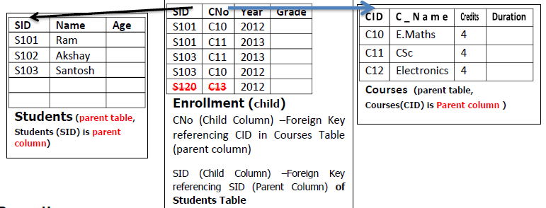
Example: Foreign Keys-Referential Constraint
Properties:
A Foreign key can contain-
  Only values present in the corresponding Parent Column/s.
  NULL values (unless additional NOT NULL constraint imposed)

Slide 22
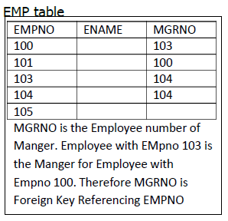
Example: Primary key and Foreign key relationship (recursive) in same table
Insert / update / Delete should not violate primary key & foreign key relationship constraints
Notes:
Insert/update/Delete should not violate primary key & foreign key relationship

Slide 23
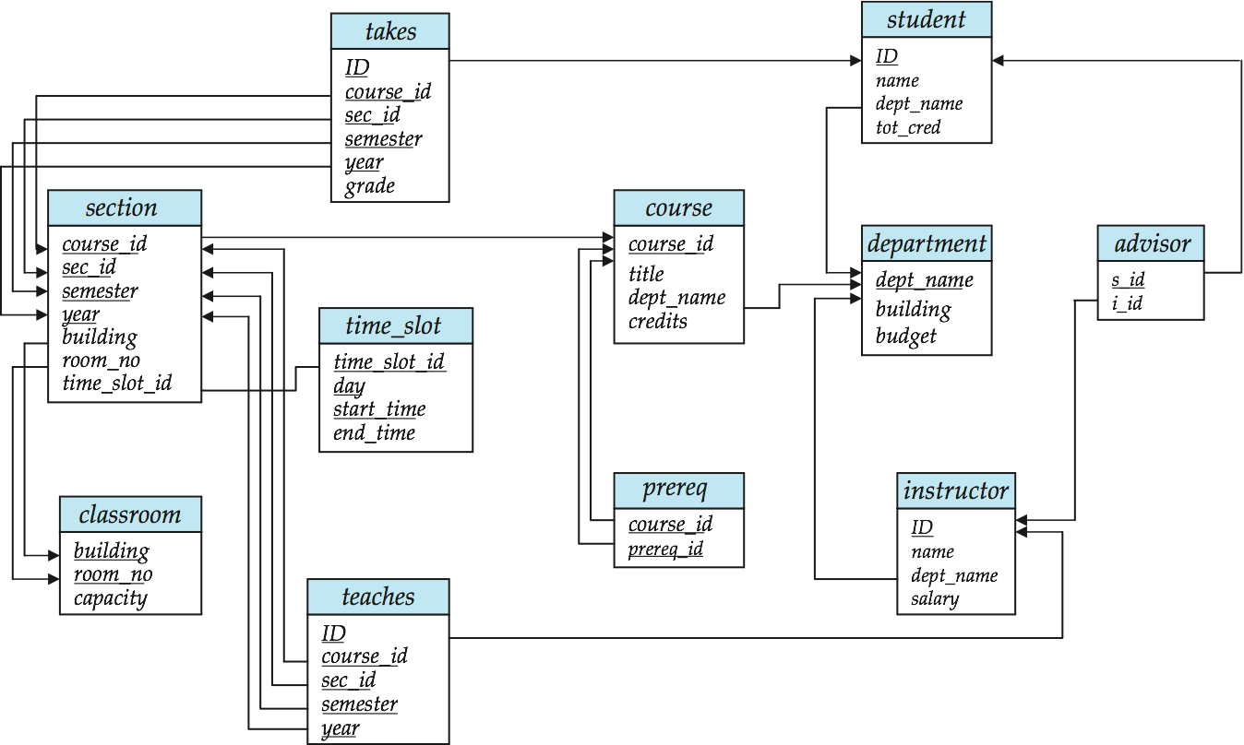
Schema Diagram for University Database
Foreign Key
Primary Key
Visit: Later in ER model chapter
Notes:
Visit: Later in ER model chapter

Slide 24
Relational Query Languages
Query languages: Allow manipulation and retrieval of data from a database.
Query Languages != programming languages
  QLs not intended to be used for complex calculations.
  QLs support easy, efficient access to large data sets.
Notes:
2

Slide 25
Formal Relational Query Languages
Two mathematical Query Languages form the basis for “real” languages (e.g. SQL), and for implementation:
  Relational Algebra: More operational(procedural), very useful for representing execution plans.
  Relational Calculus: Lets users to describe what they want, rather than how to compute it. (Non-operational, declarative.)
    Ex: result= { t| t ∈ loan ∧ t[amount]>=10000 }
Notes:
}

Slide 26
Relational Algebra
Query Language-
The relational algebra consists of a set of operations that take one or two relations as input and produce a new relation as their result.
They illustrate the fundamental techniques for extracting data from the database.

Slide 27
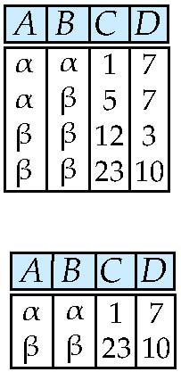
SELECT (σ) : Selection of tuples(rows)
Relation r
comparisons operators =, ≠, <, ≤, >, and ≥
connectives and (∧), or (∨), and not
Select tuples with A=B and D > 5
σ_{A=B ∧ D > 5}(r)
Quiz Q1:
σ_{A<> B ∨ D < 7} (r) has (1) 1 tuple (2) 2 tuples (3) 3 tuples (4) 4 tuples
Notes:
Quiz Q1 - Ans. 2-tuples,

Slide 28

Example: Selection of tuples(rows) (σ)
Instructor
Result
Result of Instructors having salary more than $85000
Instructor
σ_{Salary> 85000}(Instructor)
Notes:
result

Slide 29
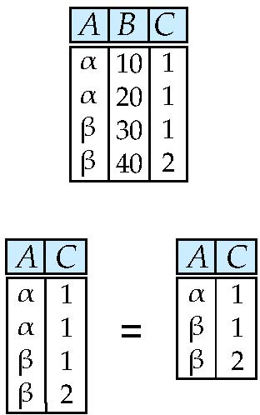
PROJECT (π ): Selection of Columns (Attributes)-
Relation r:
Select A and C attributes
  Projection
  π_{A, C}(r)
removes duplicates
Quiz Q2:
The projection operation (1) removes duplicates (2) does not remove duplicates

Slide 30
Example: PROJECT
Instructor
Result of Projection on ID and Name columns of Instructors relation.
π_{ID, Name}(Instructor)
Project Operation always- Discards duplicates, retains only one copy.
Notes:
Discards duplicates, retains only one copy.
Example: PROJECT

Slide 31
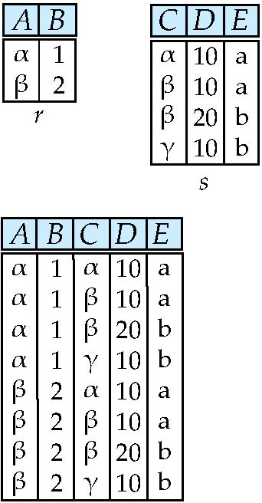
Joining two relations – Cartesian Product X..
Relations r, s:
r x s:
Number of Tuples in r X s
r_{n} – number of tuples in r
s_{n} - number of tuples in s
r X s has r_{n} * r_{s} tuples
Notes:
r_{n} – number of tuples in r
s_{n} - number of tuples in s

Slide 32
Cartesian-product – naming issue.
B
Relations r, s:
Note: Attribute B in r & s are from different domains but having same attribute name
r.B
s.B
r x s:
Notes:
Note: Attribute B in r & s are from different domains but having same attribute name

Slide 33
Renaming a Table..
Allows us to refer to a relation, (say E) by more than one name.
ρ _{x} (E)
returns the expression E under the name X
Relations r
r.A r.B s.A s.B
r x ρ _{s} (r)
α
α
β
β
1
1
2
2
α
β
α
β
1
2
1
2

Slide 34
Renaming a Table.
A second form of the rename operation-
ρ_{X (A1,A2,…,An)} (E)
Not only E is remaned as X , attributes in X are also renamed to A₁,A₂,..A_{n} respectivelly.
Relations r
r x ρ _{s(X,Y)} (r)
r.A r.B s.X s.Y
α
α
β
β
1
1
2
2
α
β
α
β
1
2
1
2
Notes:
r1(A1,A2,A3,A4,A5,A5,A7,A8,A9) rename the relation to s1 with Attribute names A1,A2,A3,A4,A5,S1,S2,S3,A9
^{ρ} s_{(A1,A2,A3,A4,A5,S1,S2,S3,A9)} (r1)

Slide 35
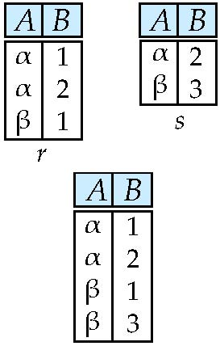
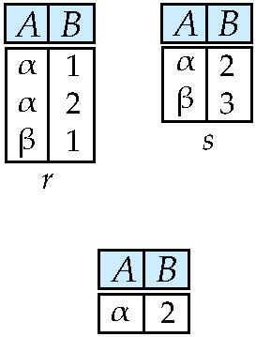
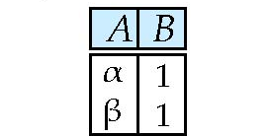
Union, Intersection & Set Difference
Relations r, s:
Two conditions
*r and s must be of the same arity
*Ith attribute in r and s must be
from same domain
Such relations are referred to as compatible relations
Union:
r ∪ s
Intersection
r ∩ s:
Set Difference
r - s:
Is this true ?
r ∩ s = r − (r − s)
tuples which are present only in r (not present in s)
Notes:
The set-difference operation, denoted by −, allows us to find tuples that are in one
relation but are not in another. The expression r − s produces a relation containing
those tuples in r but not in s.
consider a union of a set of customer names and a set of cities. Such a union would not make sense in most situations.
Therefore, for a union operation r ∪ s to be valid, we require that two conditions
hold:
Gives tuples which are present only in r(not present in s)
1. The relations r and s must be of the same arity. That is, they must have the
same number of attributes.
2. The domains of the ith attribute of r and the ith attribute of s must be the same,
for all i.
Note that r and s can be, in general, temporary relations that are the result of relational algebra expressions.

Slide 36
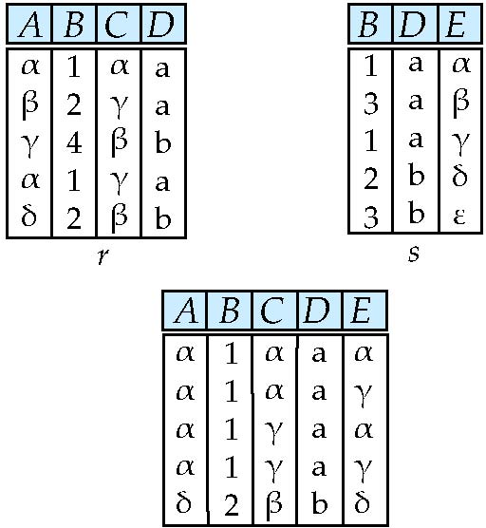

Natural Join – Joining two relations
Let r and s be relations on schemas R and S respectively.
Then, the “natural join” of relations R and S is a relation with schema R ∪ S and tuples are obtained as follows:
  Consider each pair of tuples t_{r} from r and t_{s} from s.
  If t_{r} and t_{s} have the same value on each of the attributes in R ∩ S (common attributes), add a tuple t to the result, where
    t is the concatenation of t_{r} on r and t_{s} on s
    Values of one set of common attributes is retained
t_{s}
t
t_{r}
r s
r
s
Equating attributes of the same name, and Projecting out one copy of each pair of equated attributes
Notes:
Schema R means attributes (A,B,C,D) ; Schema S means (B,D,E) ; Schema R U S means (A,B,C,D,E) ; R ∩ S means (B,D)
Equating attributes of the same name, and Projecting out one copy of each pair of equated attributes.
Natural Join- Outputs the pairs of rows from the two input relations that have the same value on all attributes that have the same name.
t is the concatenation of t_{r} and t_{s} while retaining values of only one set of common attributes

Slide 37
Natural Join Example
Relations r, s:
Cartesian product(X) followed
by SELECT(σ) operation.
Selection is based on
equality on common
Attributes in both relations.
Finally removes duplicate attributes
Natural Join
  r s equivalent to
∏ _{A, r.B, C, r.D, E} (σ _{r.B = s.B ˄ r.D = s.D} (r x s)))
In general, Consider two relations r(R) and s(S).
R ∩ S = {A1, A2, . . .,An}.
Quiz Q3: The natural join operation matches tuples (rows) whose values
for common attributes are (1) not equal (2) equal (3) weird Greek letters (4) null
Notes:
The natural-join operation forms a Cartesian product of its two arguments, performs a
selection forcing equality on those attributes that appear in both relation schemas,
and finally removes duplicate attributes.

Slide 38
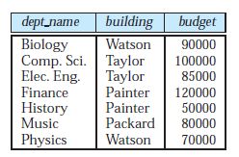
Natural Join
Example: Sample Relation
Department
Instructor
Notes:
Example: Sample Relation

Slide 39
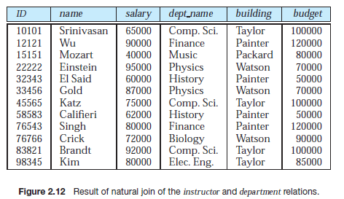
Example: Natural Join
  Instructor Department
Notes:
Example: Natural Join

Slide 40

Theta join
The theta join operation is a variant of the natural-join operation that allows us to combine a Cartesian product and a selection( based on any kind of condition between attributes) into a single operation.
Consider relations r (R) and s(S), and let ɵ be a predicate(condition) on attributes in the schema R ∪ S.
The theta join operation on r , s is defined as follows:
It is equivalent to-
        Take the product r Χ s.
        Then apply σ_{ɵ} to the result.
  As for σ, ɵ can be any Boolean-valued condition. Historic versions of this operator allowed only A θ B, where θ is =, <, etc.; hence the name “theta-join.”
Notes:
It is equivalent to

Slide 41
Theta Join Example
EMP
EMPCODE | NAME | Deptno | Salary
100 | RAJESH | D1 | 100000
101 | RAVI | D2 | 120000
102 | VIJAY | D1 | 100000
108 | AJAY | D3 | 140000
110 | BHASKAR | D2 | 120000
106 | RAJ | D2 | 150000
105 | MANISH | D3 | 190000
106 | PRSAD | D1 | 200000
DEPT
Dno | Zone | HeadOffice
D1 | North | N.Delhi
D2 | West | Mumbai
D3 | South | Bangalore
D4 | Centre | Nagpur
Note: Deptno is foreign key referencing Dno
1. Find Name of employees working in West Zone.
ΠName (EMP ⋈ Deptno=Dno ˄ Zone=‘West’ DEPT )
2. Find Name, Zone of employees drawing salary more than 150000/-
Πname,Zone (EMP ⋈ Deptno=Dno ˄ Salary>150000 DEPT )
Notes:
Note: Deptno is foreign key referencing Dno
Find Name of employees working in West Zone.
EMP
DEPT

Slide 42
Theta Join Example
1. Find Name of employees working in West Zone.
EMPCODE | NAME | Deptno | Salary | Zone | HeadOffice
100 | RAJESH | D1 | 100000 | North | N.Delhi
101 | RAVI | D2 | 120000 | West | Mumbai
102 | VIJAY | D1 | 100000 | North | N.Delhi
108 | AJAY | D3 | 140000 | South | Bangalore
110 | BHASKAR | D2 | 120000 | West | Mumbai
104 | RAJ | D2 | 150000 | West | Mumbai
105 | MANISH | D3 | 190000 | South | Bangalore
106 | PRSAD | D1 | 200000 | North | N.Delhi
EMP ⋈ Deptno=Dno
EMPCODE | NAME | Deptno | Salary | Zone | HeadOffice
100 | RAJESH | D1 | 100000 | North | N.Delhi
101 | RAVI | D2 | 120000 | West | Mumbai
102 | VIJAY | D1 | 100000 | North | N.Delhi
108 | AJAY | D3 | 140000 | South | Bangalore
110 | BHASKAR | D2 | 120000 | West | Mumbai
104 | RAJ | D2 | 150000 | West | Mumbai
105 | MANISH | D3 | 190000 | South | Bangalore
106 | PRSAD | D1 | 200000 | North | N.Delhi
EMP ⋈ Deptno=Dno ˄ Zone=‘West’ DEPT
ΠName (EMP ⋈ Deptno=Dno ˄ Zone=‘West’ DEPT )

Slide 43
Theta Join Example
2. Find Name, Zone of employees drawing salary more than 150000/-
EMPCODE | NAME | Deptno | Salary | Zone | HeadOffice
100 | RAJESH | D1 | 100000 | North | N.Delhi
101 | RAVI | D2 | 120000 | West | Mumbai
102 | VIJAY | D1 | 100000 | North | N.Delhi
108 | AJAY | D3 | 140000 | South | Bangalore
110 | BHASKAR | D2 | 120000 | West | Mumbai
104 | RAJ | D2 | 150000 | West | Mumbai
105 | MANISH | D3 | 190000 | South | Bangalore
106 | PRSAD | D1 | 200000 | North | N.Delhi
EMP ⋈ Deptno=Dno
EMPCODE | NAME | Deptno | Salary | Zone | HeadOffice
105 | MANISH | D3 | 190000 | South | Bangalore
106 | PRSAD | D1 | 200000 | North | N.Delhi
EMP ⋈ Deptno=Dno ˄ Salary>150000 DEPT
Πname,Zone (EMP ⋈ Deptno=Dno ˄ Salary>150000 DEPT )
NAME | Zone
MANISH | South
PRSAD | North

Slide 44

Aggregate Functions and Operations
Aggregation function takes a collection of values and returns a single (aggregate) value as a result.
avg: average value
min: minimum value
max: maximum value
sum: sum of values
count: number of values
Aggregate operation in relational algebra
E is any relational-algebra expression/ a relation
  G₁, G₂ …, G_{n} is a list of attribute/s on which to group (can be empty)
  Each F_{i} is an aggregate function
  Each A_{i} is an attribute name on which aggregate function applied.
Note: Some books/articles use γ (gamma) instead of (Calligraphic G)
Notes:
Aggregate operations involve , first grouping records based on some attributes (designated as G₁,G₂… in the slide), secondly applying aggregation operation(such as avg,min,sum etc) on the attributes( F₁(A₁),…) of groups formed.

Slide 45
Aggregate Operation – Example
Relation r:
A
B
C
α
α
β
β
α
β
β
β
7
7
3
10
_{sum(c)} (r)
sum(c )
What is the result for the following expression ?
_{A,B} _{sum(c)} (r)
27
_{A} _{sum(c)} (r)
A
sum(c )
α
β
14
13
Notes:
What is the result for
In Oracle
SELECT A, Sum(C) FROM r GROUP BY A,B; this will give error because you can’t get a aggregate(single) value for A as Grouping is based on A,B,
But
SELECT A,B, Sum(C) FROM r GROUP BY A,B; this will not give error.

Slide 46
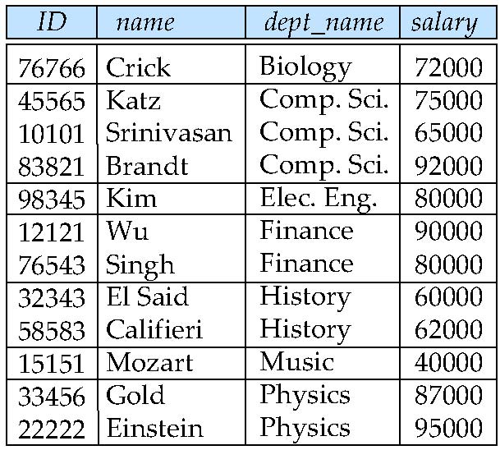
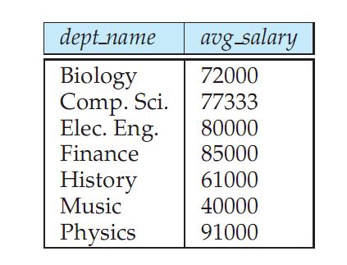
Aggregate Operation – Example
Find the average salary in each department
_{dept_name} _{avg(salary)} (instructor)

Slide 47
Aggregate Operation – Example
Find the total amount spent by each department as a salary.
_{dept_name} _{Sum(salary)} (instructor)

Slide 48
Aggregate Operation – Example
Find the number of employees working in each department.
_{dept_name} _{Count(ID)} (instructor)

Slide 49
Outer Join – Base relations- Loan , Borrower
Relation loan
loan_number
branch_name
amount
L-170
L-230
L-260
Downtown
Redwood
Perryridge
3000
4000
1700
Relation borrower
customer_name
loan_number
Jones
Smith
Hayes
L-170
L-230
L-155

Slide 50
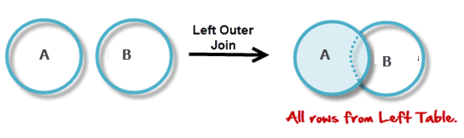
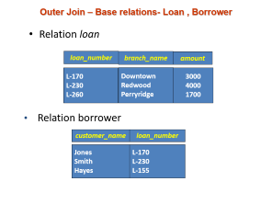

Join & Left Outer Join – Example
Join
loan borrower
loan_number
branch_name
amount
customer_name
L-170
L-230
Downtown
Redwood
3000
4000
Jones
Smith
Left Outer Join
loan borrower
loan_number
branch_name
amount
customer_name
L-170
L-230
L-260
Downtown
Redwood
Perryridge
3000
4000
1700
Jones
Smith
null

Slide 51
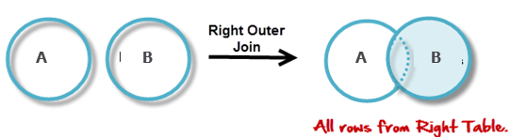


Right Outer Join & Full Outer Join – Example
Right Outer Join
loan borrower
loan_number
branch_name
amount
customer_name
L-170
L-230
L-155
Downtown
Redwood
null
3000
4000
null
Jones
Smith
Hayes
Full Outer Join
loan borrower
loan_number
branch_name
amount
customer_name
L-170
L-230
L-260
L-155
Downtown
Redwood
Perryridge
null
3000
4000
1700
null
Jones
Smith
null
Hayes

Slide 52
Composition of Relational Operations
The result of a relational-algebra operation is of the same type (relation) as its inputs(relations).
Resultant_Relation ← Realtion_1 R.Algbraic_Operation Relation_2
Many different relational-algebra operations can be composed together into a
relational-algebra expression.
“Find the names of all instructors in the Physics department.”
Πname (σdept name =“Physics” (instructor))
Exercise: Consider a relations A( ID, Name, Age) , B(ID, Phone, Area) , C(ID, Salary, DeptNo)
Write a relational Algebraic expression to find ID, Name, Phone of Employees.
Notes:
A( ID, Name, Age)
Since the result of a relational-algebra operation is of the same type
(relation) as its inputs, relational-algebra operations can be composed together into a
relational-algebra expression. Composing relational-algebra operations into relational algebra
expressions is just like composing arithmetic operations

Slide 53
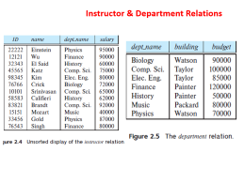

Assignment Operator
The assignment operation, denoted by ←, works like assignment operator = in a programming language.
The result to the right of the ← is assigned to the relation variable on the left of the ←
While writing a relational-algebra expression, it is convenient to assigning parts of it to temporary relation variables.
Eg. temp1 ← R × S
  temp1 relation variable may used in subsequent expressions.
    temp2 ← σ r.A1 =s.A1 ∧ r.A2 =s.A2 ∧...∧ r.An =s.An (temp1)
Example: “Find the names of all instructors in the Physics department.”
Temp_phy ← (σdept name =“Physics” (instructor))
Πname (Temp_phy )

Slide 54
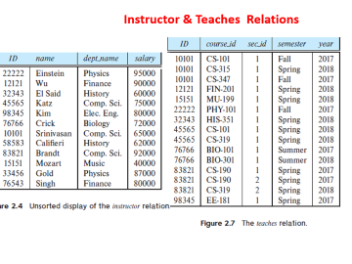

Equivalent Queries
Find information about courses taught by instructors in the Physics department
σdept name=“Physics”(instructor ⋈instructor.ID=teaches.ID teaches)
Both queries are equivalent
(σdept name=“Physics”(instructor)) ⋈instructor.ID=teaches.ID teaches
Notes:
Both queries are equivalent

Slide 55
Example:
Find the name of Employee and their Manger Names.
EMP
EMPCODE | NAME | Deptno | Salary | MGR_NO
100 | RAJESH | D1 | 100000 | 102
101 | RAVI | D2 | 120000 | 102
102 | VIJAY | D1 | 100000 | 105
108 | AJAY | D3 | 140000 | 105
110 | BHASKAR | D2 | 120000 | 106
104 | RAJ | D2 | 150000 | 105
105 | MANISH | D3 | 190000 | 106
106 | PRSAD | D1 | 200000
EMP1
EMPCODE | NAME | Deptno | Salary | MGR_NO
100 | RAJESH | D1 | 100000 | 102
101 | RAVI | D2 | 120000 | 102
102 | VIJAY | D1 | 100000 | 105
108 | AJAY | D3 | 140000 | 105
110 | BHASKAR | D2 | 120000 | 106
104 | RAJ | D2 | 150000 | 105
105 | MANISH | D3 | 190000 | 106
106 | PRSAD | D1 | 200000
Note: MGR_NO must be foreign key referencing EMPCODE
_{EMP1} (EMP)
Π_{EMP.name,EMP1.Name} (EMP ⋈ MGR_NO=EMPCODE EMP1)
Notes:
Example:
Note: MGR_NO must be foreign key referencing EMPCODE
Find the name of Employee and their Manger Names.
We get Employee information from EMP and corresponding Manager Employee information concatenated available in EMP1

Slide 56
Aggregate Operation – Example
EMP
EMPCODE | NAME | Deptno | Salary
100 | RAJESH | D1 | 100000
101 | RAVI | D2 | 120000
102 | VIJAY | D1 | 100000
108 | AJAY | D3 | 140000
110 | BHASKAR | D2 | 120000
106 | RAJ | D2 | 150000
105 | MANISH | D3 | 190000
106 | PRSAD | D1 | 200000
DEPT
Dno | Zone | HeadOffice
D1 | North | N.Delhi
D2 | West | Mumbai
D3 | South | Bangalore
D4 | Centre | Nagpur
Note: Deptno is foreign key referencing Dno
1. Find number of employees in Centre, West Zones respectively.
Temp1← (EMP ⋈ Deptno=Dno ˄ (Zone=‘West’ ∨ Zone=‘Centre’ )DEPT )
_{Zone} _{Count(ID)} (Temp1)
Notes:
Note: Deptno is foreign key referencing Dno
Find Name of employees working in West Zone.
EMP
DEPT

Slide 57
Summary of Relational Algebra Operators
Symbol (Name) Example of Use
σ
(Selection) ^{σ} salary > = 85000 ^{(instructor)}
Return rows of the input relation that satisfy the predicate.
Π
(Projection) ^{Π} ID, salary ^{(instructor)}
Output specified attributes from all rows of the input relation. Remove duplicate tuples from the output.
x
(Cartesian Product) instructor x department
Output pairs of rows from the two input relations that have the same value on all attributes that have the same name.
∪
(Union) ^{Π} name ^{(instructor) ∪ Π} name ^{(student)}
Output the union of tuples from the two input relations.
-
(Set Difference) ^{Π} name ^{(instructor)} ^{-- Π} name ^{(student)}
Output the set difference of tuples from the two input relations.
⋈
(Natural Join) instructor ⋈ department
Output pairs of rows from the two input relations that have the same value on all attributes that have the same name.

Slide 58
Exercise
Consider a relations A( ID, Name, Age) , B(EID, Phone, City) , C(ID, Salary, DeptName)
Note: EID and ID derived from Same domain
Write a relational Algebraic expression –
  To find ID, Name, Phone of Employees.
  To find Name of Employees having Salary>90000
  To find DeptName and total salary of each department.
  To find Name of Employees who from city - Manipal
Notes:
PROJECT_{ID, Name, Phone} (A)
PROJECT _{Name} (SELECT _{Salary>90000} ( A N.JOIN C ) ) other way is PROJECT _{Name} ((SELECT _{Salary>90000} ( C )) N.JOIN A )
_{DeptName} G_{sum(Salary)} (C)

Slide 59
Solution:
A( ID, Name, Age) , B(EID, Phone, City) , C(ID, Salary, DeptName)
Note: EID and ID derived from Same domain
  To find ID, Name, Phone of Employees.
    PROJECT_{ID, Name, Phone} (A Theat_{ID=EID} B)
  To find Name of Employees having Salary>90000
    PROJECT _{Name} (SELECT _{Salary>90000} ( A N.JOIN C ) ) other way is
    PROJECT _{Name} ((SELECT _{Salary>90000} ( C )) N.JOIN A )
  To find DeptName and total salary of each department.
    _{DeptName} G _{SUM(Salary)} (C)
  To find Name of Employees who from city - Manipal
    PROJECT _{Name} (A Theta _{(ID=EID AND City=‘Manipal’)} B)

Slide 60
END

Slide 61
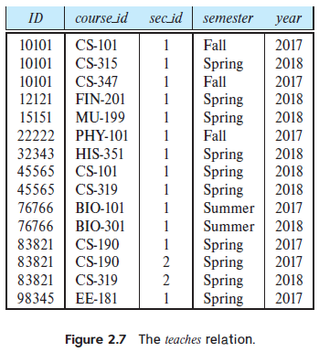
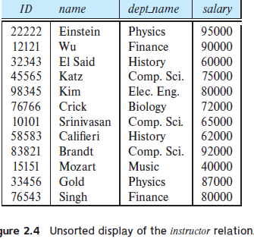
Instructor & Teaches Relations

Slide 62
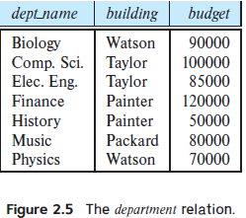
Instructor & Department Relations
Notes:
Instructor & Department

